Slide 1
My BANK BANKING APPLICATION
TEAM : FINANCE TITANS
MODULE : PAYMENT TRANSFER

Slide 2
Agenda
Introduction
Features
Architecture Diagram
DB design
Flow Diagram
Jar file and git hub links

Slide 3

INTRODUCTION
The payment transfer module is a fundamental component within financial systems, enabling the movement of funds between accounts. This includes transfers within the same financial institution or between different institutions, as well as processing different types of payments like one-time, recurring, and scheduled payments.

Slide 4
OverView
Display all payee
Delete payee
Add new payee
Transaction

Slide 5
Features
Display Payee Details
Description: Users have the ability to access payee details by entering their account number.
Functionality: Retrieves payee information from the system's database based on the provided account number. If the account number is not there it will display appropriate message.

Slide 6
VIEW ALL PAYEES
Upon Successful login we redirect the user to dashboard, in the navigation bar user can select for viewing the payee details or user can add new payees.
On selecting view all payees we provide drop down to users which has account number related to the logged in user. We provide a drop down to select the account number for which user want to view payee.
After selecting account number we display payee details in cards, each card has two buttons one to do transaction and another to delete the payee.

Slide 7
Delete PayeE
On clicking on the delete button in displayed cards the selected payee is deleted with the confirmation button.

Slide 8
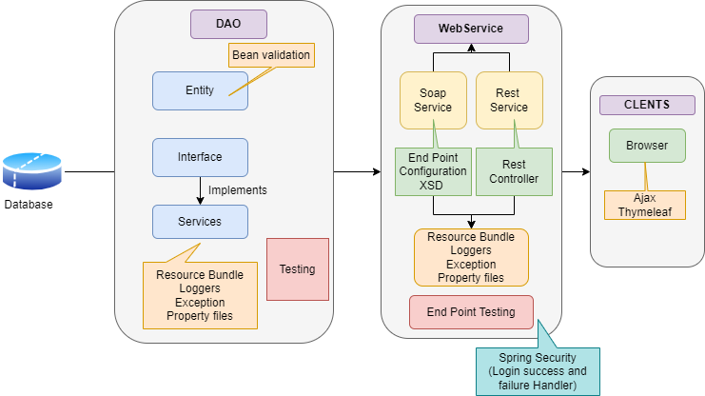
ARCHITECTURE DIAGRAM

Slide 9
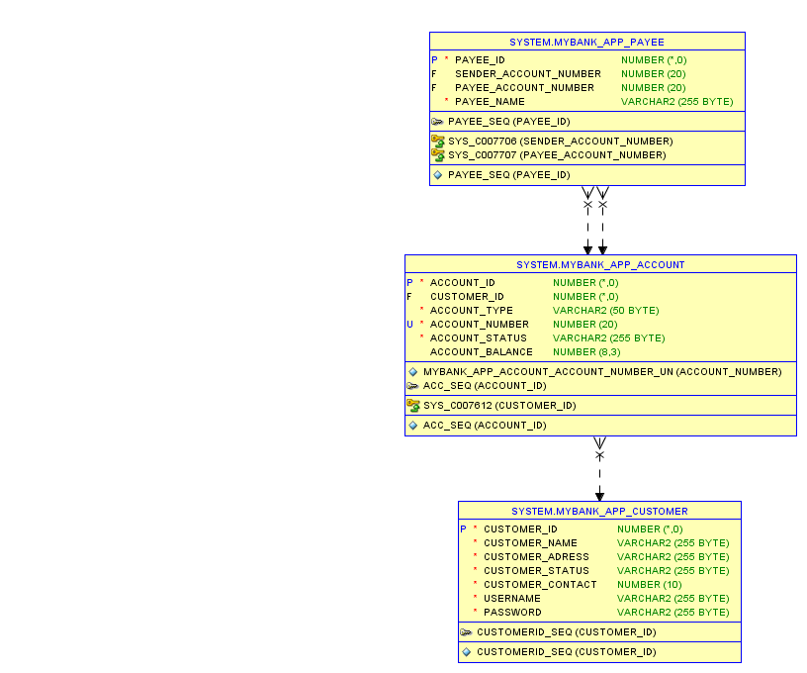
DB DESIGN

Slide 10
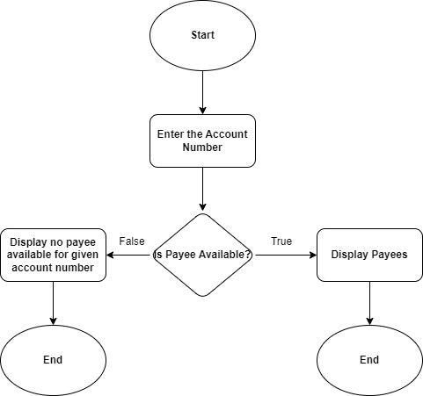
DATAFLOW DIAGRAM​

Slide 11
Second Module (DELETE PAYEE)
Entering the payee details which includes payee id, payee account number, sender account number and payee name.
If the payee exists then delete payee.
If payee not exists it display an appropriate message

Slide 12
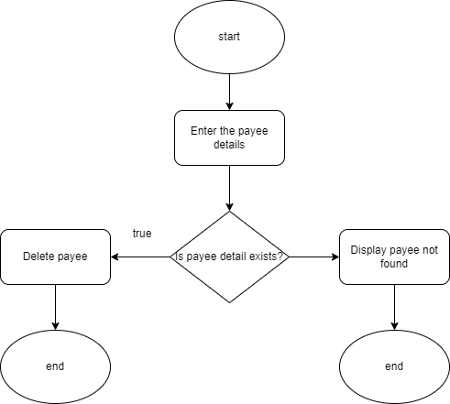
Module 2 DATAFLOW DIAGRAM

Slide 13
LINKS
Git Hub :https://github.com/Arundhathi-Nayak/DLTE-JAVA-FULL-STACK-ARUNDHATHI-NAYAK-2024/tree/master/PROJECT
Jar Files :
DAO : payment-1.0.0-SNAPSHOT.jar
Web Service : webservice-1.0.0-SNAPSHOT.war

Slide 14
THANK YOU

